Slide 1
ASTRO
Specialized bot to take orders

Slide 2

OUR COMPANY
We are a company dedicated to repairing and maintaining Xbox One controllers at a fair price. Without a doubt, if you will leave your control in the hands of someone, we are the best option.

Slide 3
ABOUT THE PROJECT
The product that will be developed, will be, in essence, an automatization of the customer service system on a generic business of reparations. This product is expected to be implemented on the enterprise’s Telegram. The product also will develop a register of the client's data

Slide 4

PROJECT UPDATE
Project Status
Project Summary
Plans for Next Week
The project has had a transition to another programming language, so there has been a delay in the established dates.
Database created
JavaScript difficulties for backend development
Bot uploaded to the cloud
MVC Design
Switch to Java language
Have at least 85% of the bot done
Planned Date
Actual Date
Tasks | Status | Start | Finish | Start | Finish | %
Bot creation | Ongoing | 11/08 | 12/05 | 11/11 | - | 60
Database creation | Completed | 10/14 | 10/28 | 10/14 | 10/28 | 100
Creation of classes and packages | Ongoing | 09/28 | 10/12 | 11/25 | - | 40
Upload everything to the cloud | Ongoing | 12/09 | 12/11 | 11/23 | - | 50

Slide 5
PROJECT UPDATE
0-1 Month
0-2 Months
Release 1.0
Define project
Class Diagram
Document
Release 2.0
Creation of the database
Progress with the bot
Upload to the cloud
First delivery
After a month, the project and how it would be carried out was defined.
Second delivery
38%
The outstanding 38% will be completed within the next 3 weeks

Slide 6
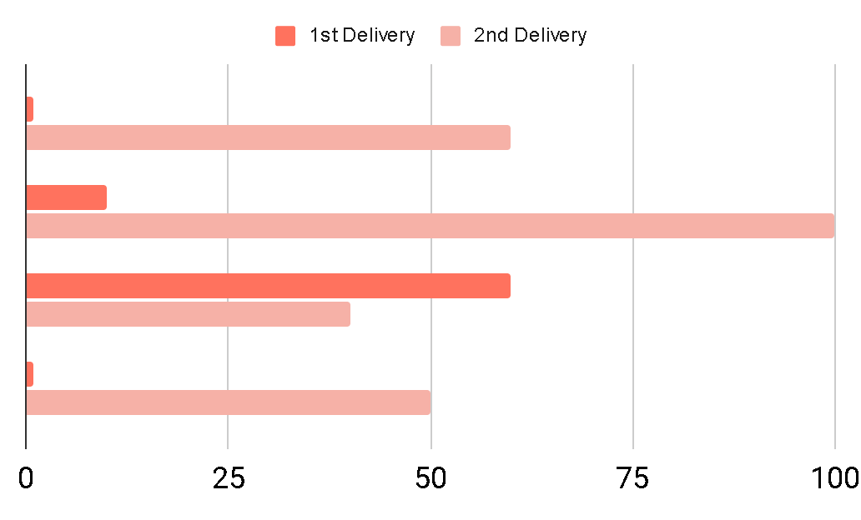
OUR PROGRESS
OBJECTIVES
62%
38%
Progress
The rest

Slide 7
IN THE FUTURE
We expect to finish the project completely, working correctly from the cloud.

Slide 8
THE GREATEST RISKS
Non-object oriented language
Lack of time
We are very close to the delivery date, and one of the biggest risks we have is time, as it makes it difficult for us to move forward calmly.
When using JavaScript for the Telegram bot, we have the disadvantage that this language is not object oriented, this makes it difficult to reuse code and connect classes.

Slide 9
OUR TEAM
RUTH CASTRO
RAFAEL PEREA
OMAR ARIAS
Scrum máster
Development team
ENRIQUE CHIM
Development team
Business owner/Development team

Slide 10
THANK
YOU!!!!!

